Slide 1
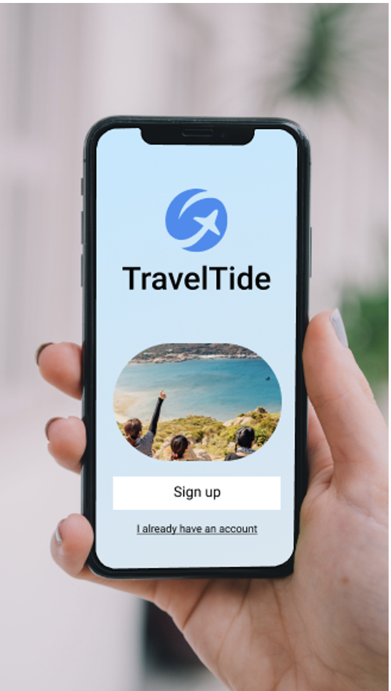
Travel Tide
Customer Segmentation Analysis & Perk’s Distribution
By - Sneha Vora

Slide 2
Travel Tide Rewards Program
Travel Tide currently consists of around 1 million users
We have have over 5 million unique app sessions with our users
Our Aim was to identify distinct segments within Travel Tide's customer base.
To tailor travel perks in our rewards program to these segments, and enhancing customer retention.

Slide 3
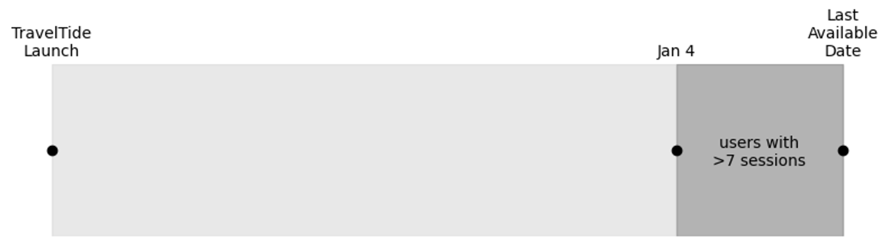
Targeted Users
Travel Tide currently consists of around 1.6m users
As Suggested by Elena, we include users with more than 7 sessions since Jan 4, 2023
This lead to 5998 users that are eligible for our rewards program

Slide 4
Customer Segmentation
To find meaningful groups, we explored customer characteristics
Based our metrics on three fields:
Session behaviour
Trip behaviour
Customer demographics
We have Utilise K-Means Algorithm to identify unique cluster based on user preference we got our 4 unique cluster having unique user id

Slide 5
Perks Distribution
To get an individualised, perk for each customer, we used segmentation into groups
After analysis, we came up with 8 groups

Slide 6
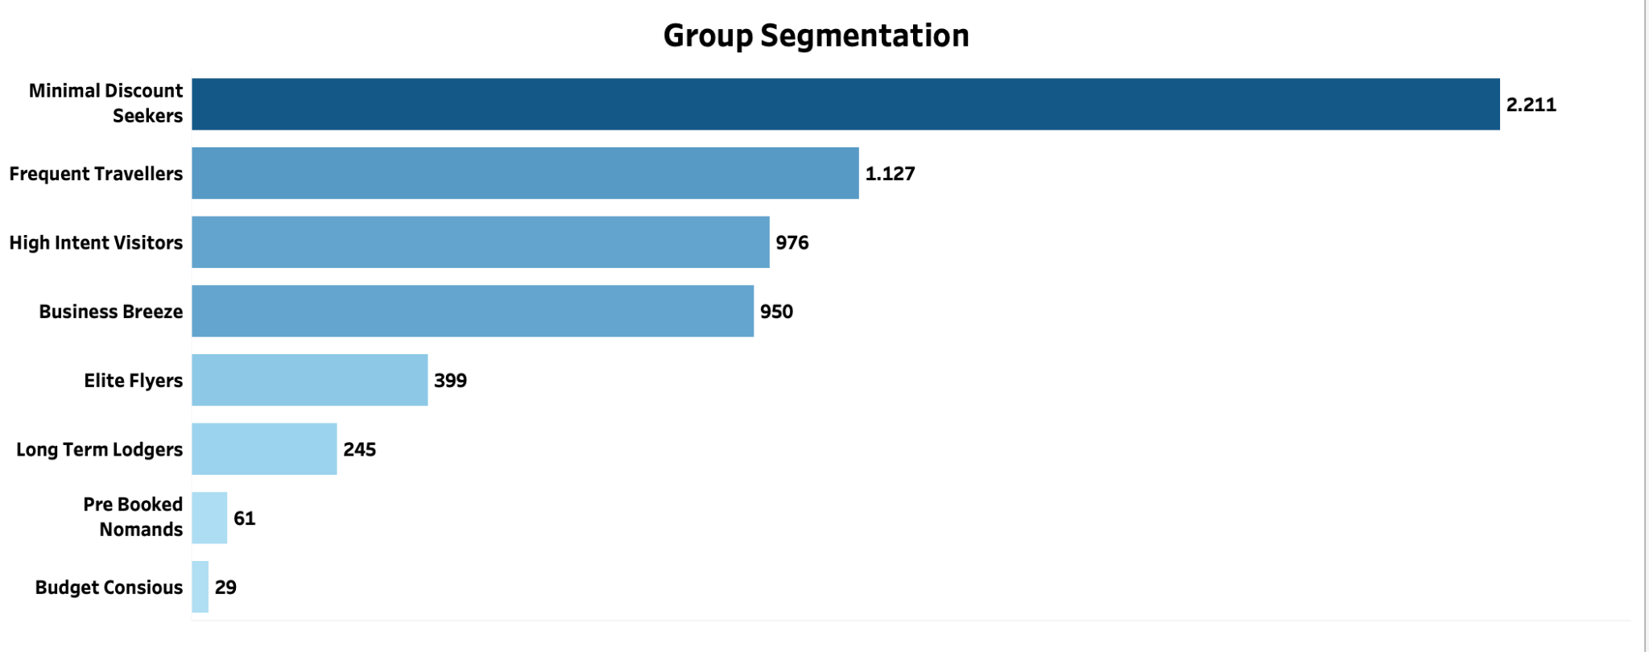

Slide 7
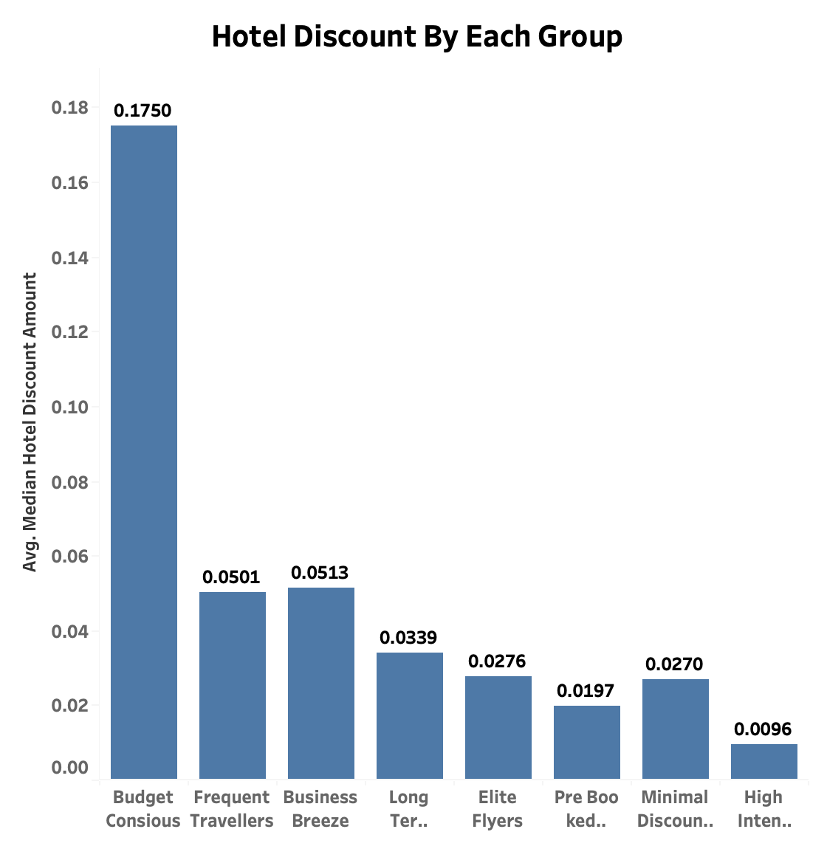
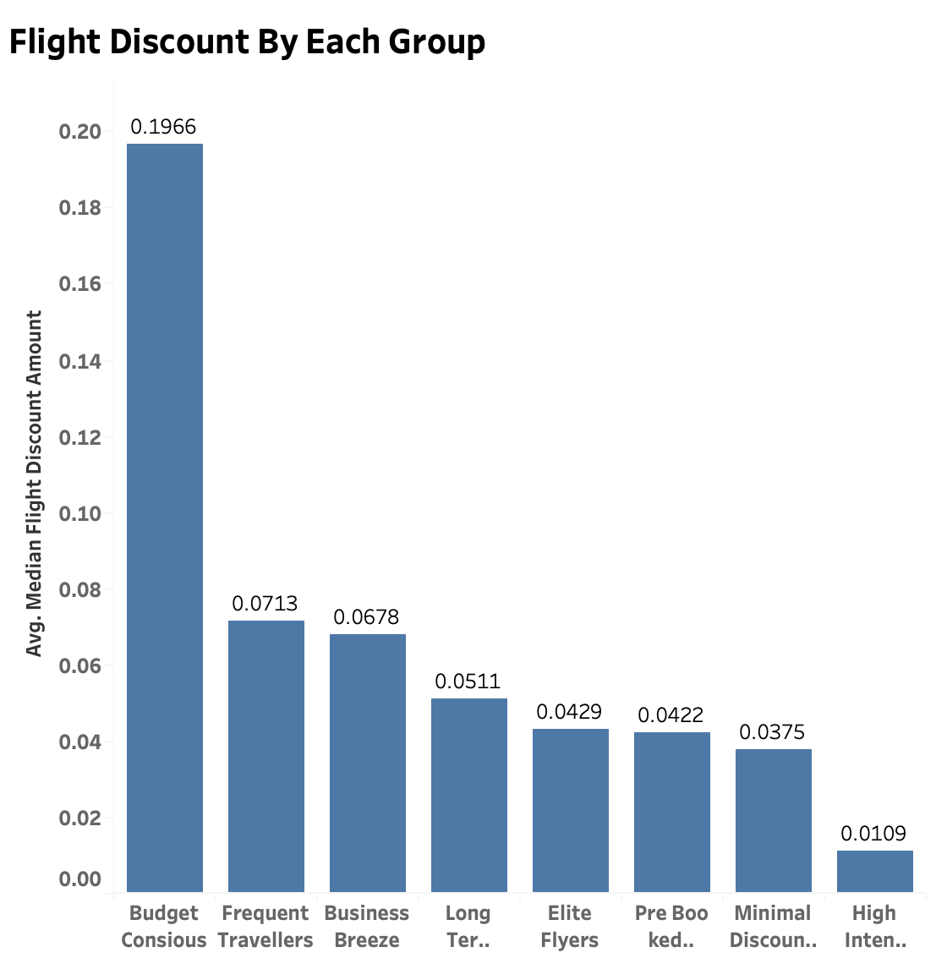
Minimal Discount Seekers
Offer: Loyalty Rewards
Exclusive rewards designed for customers who prioritise value over discounts. Accumulate points with each booking, redeemable for upgrades and special perks.

Slide 8
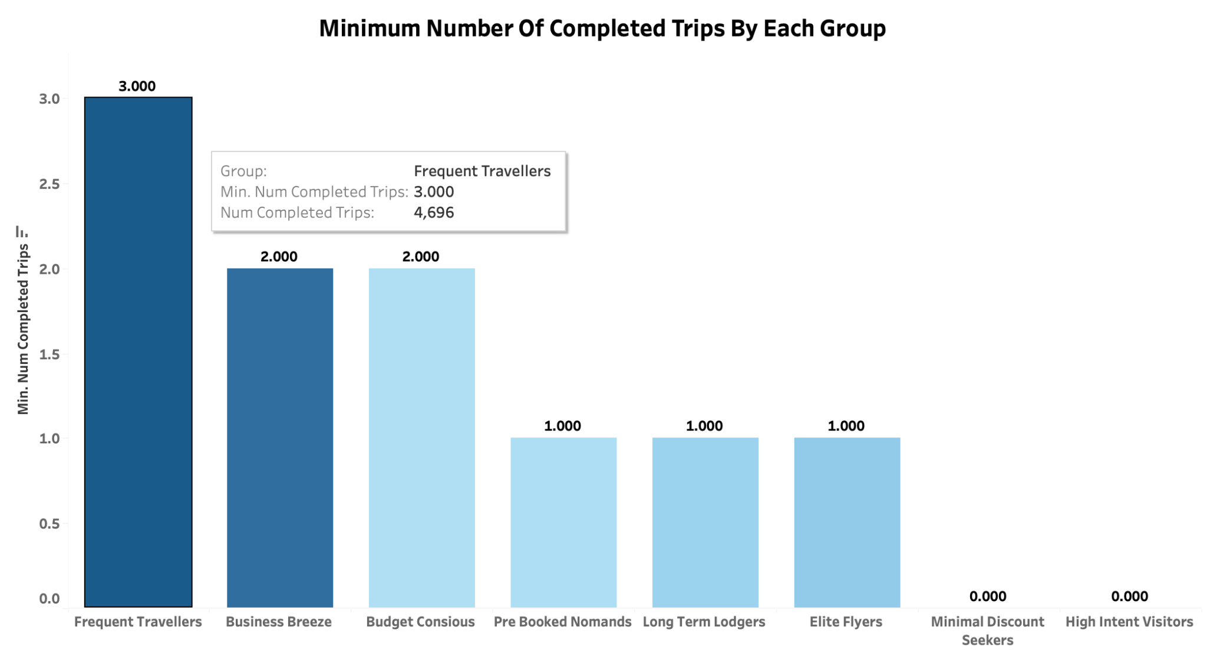
Frequent Travellers
Offer: Earn Jet Miles Points with every trip
Implement a loyalty program where customers earn points for each trip, which can be redeemed for future travel.

Slide 9
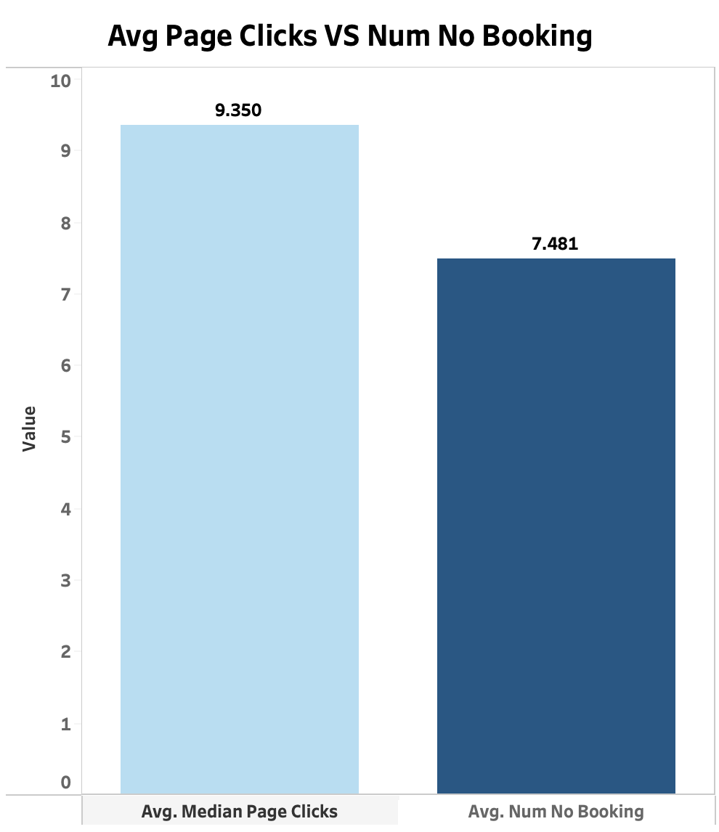
High Intent Visitors (Dreamers)
Offer: 20% off on first booking
Provide a substantial discount on the first booking to encourage app users who frequently browse but have not yet made a purchase.
A significant discount can be a strong motivator for first-time bookings.

Slide 10
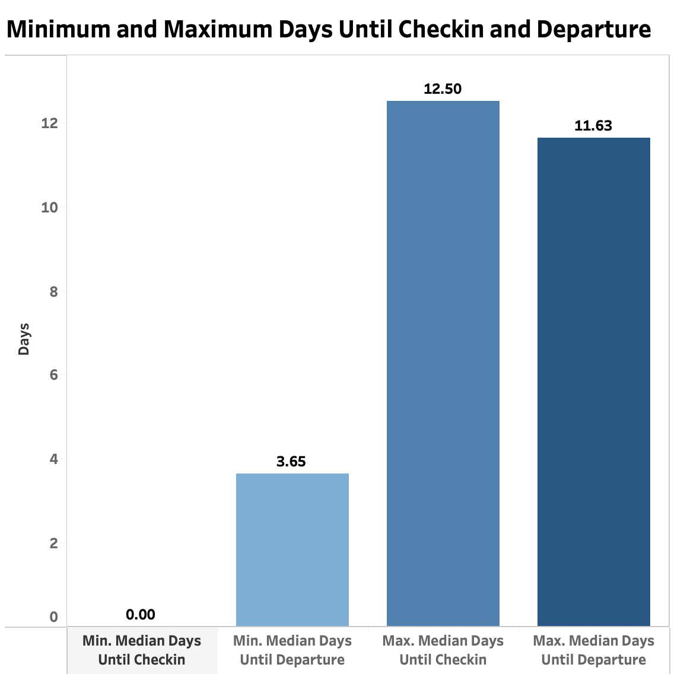
Business Breeze
Offer: Free Cancellation
Provide the flexibility of free cancellations to accommodate last-minute changes often required by business travellers
.
Business travellers need flexibility due to unpredictable schedules. Free cancellation offers them peace of mind and convenience

Slide 11
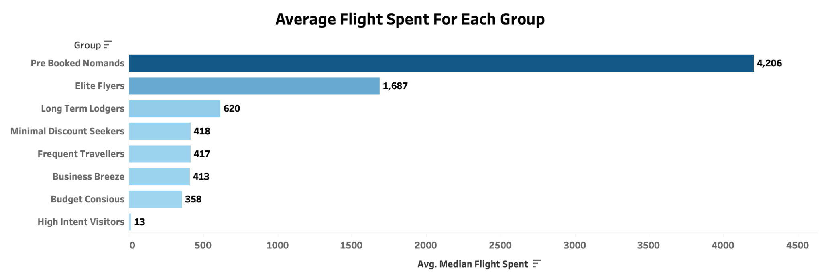
Elite Flyers
Offer: 1 Extra Bag with VIP Lounge Access
Offer an additional checked baggage allowance and access to exclusive VIP Lounges. This enhances their travel comfort and convenience.

Slide 12
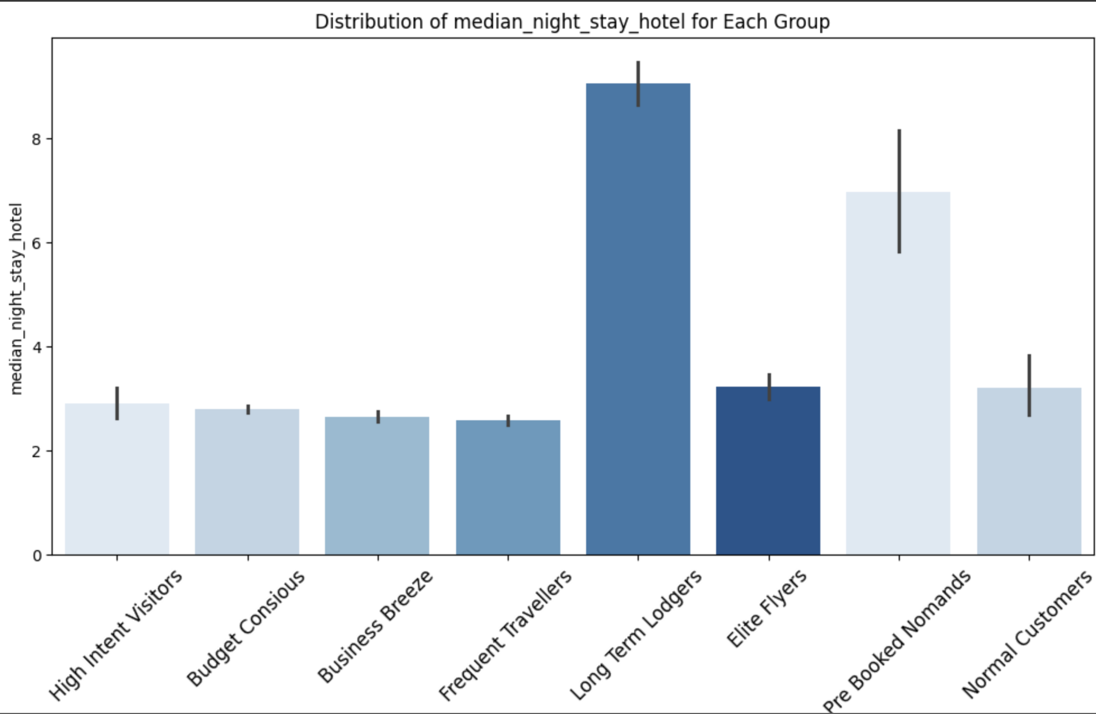
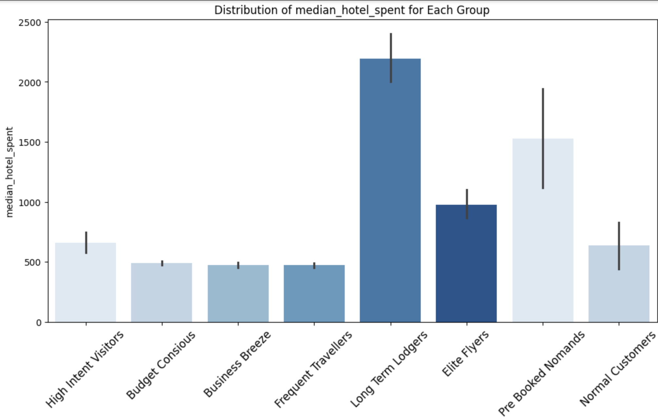
Long Term Lodgers
Offer: 1 Night with Hotel Meal Free
Provide a complimentary night's stay and a hotel meal for customers on extended trips. This adds value to their long-term accommodations.

Slide 13
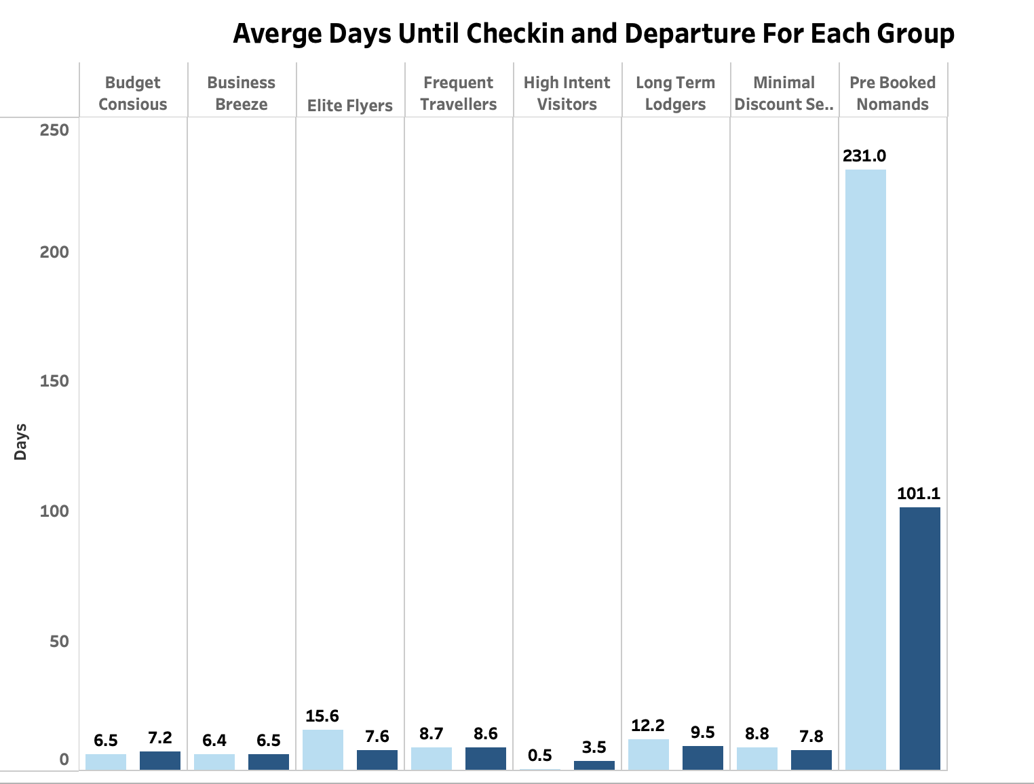
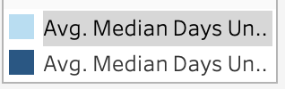
Pre Booked Nomads
Offer: Early Bird Bonuses
Provide special discounts and perks to customers who book their trips well in advance.This initiative encourages proactive planning and secures bookings well in advance.

Slide 14

Budget Conscious
Offer: Exclusive Discounts
There are only 29 customers
Offer special discounts to price-sensitive customers who look for the best deals.
Many frequent travellers are cost-conscious. Exclusive discounts make your service more attractive to them, encouraging repeat business.

Slide 15
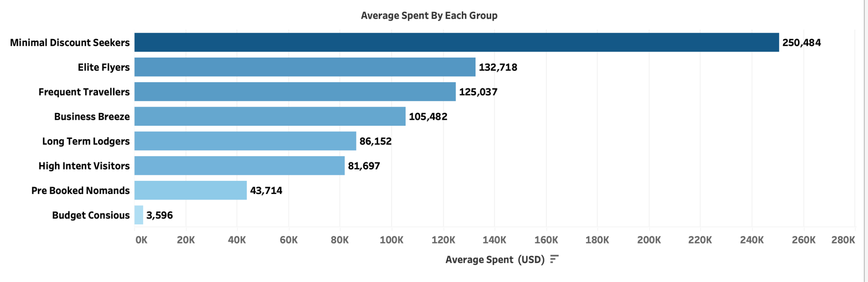

Slide 16
Recommendations
A/B Testing for Segment Validation It is recommended to conduct A/B testing to validate the effectiveness of targeted perks for each customer segment identified. This approach will utilize metrics such as conversion rates and customer engagement to refine our strategies. The testing phase is anticipated to run for 4-6 weeks to gather comprehensive data.
Launching the Rewards Programme Utilizing segmented data insights, initiate a targeted email campaign that prioritizes high-value customers identified by their average spending habits. Evaluate the program's effectiveness through key performance indicators such as customer lifetime value and engagement rates to ensure strategic alignment and maximize impact.
Continuous Monitoring Regular monitoring and reporting of KPIs will be crucial for ongoing optimization of the rewards program. This proactive approach ensures timely adjustments to maximize program effectiveness and customer satisfaction.

